Slide 1
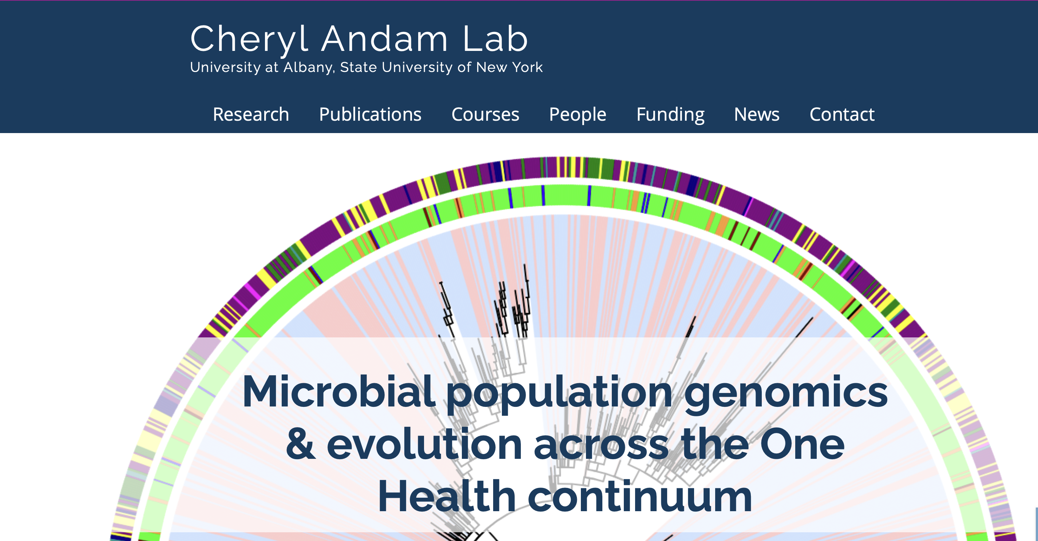
Evolutionary relationships and antimicrobial resistance of Staphylococcus aureus in humans, ruminants and companion animals HAFEEZ AKINNIYI SUMMER RESEARCH FELLOW
Notes:
I made some changes to this slide to make it look better.

Slide 2
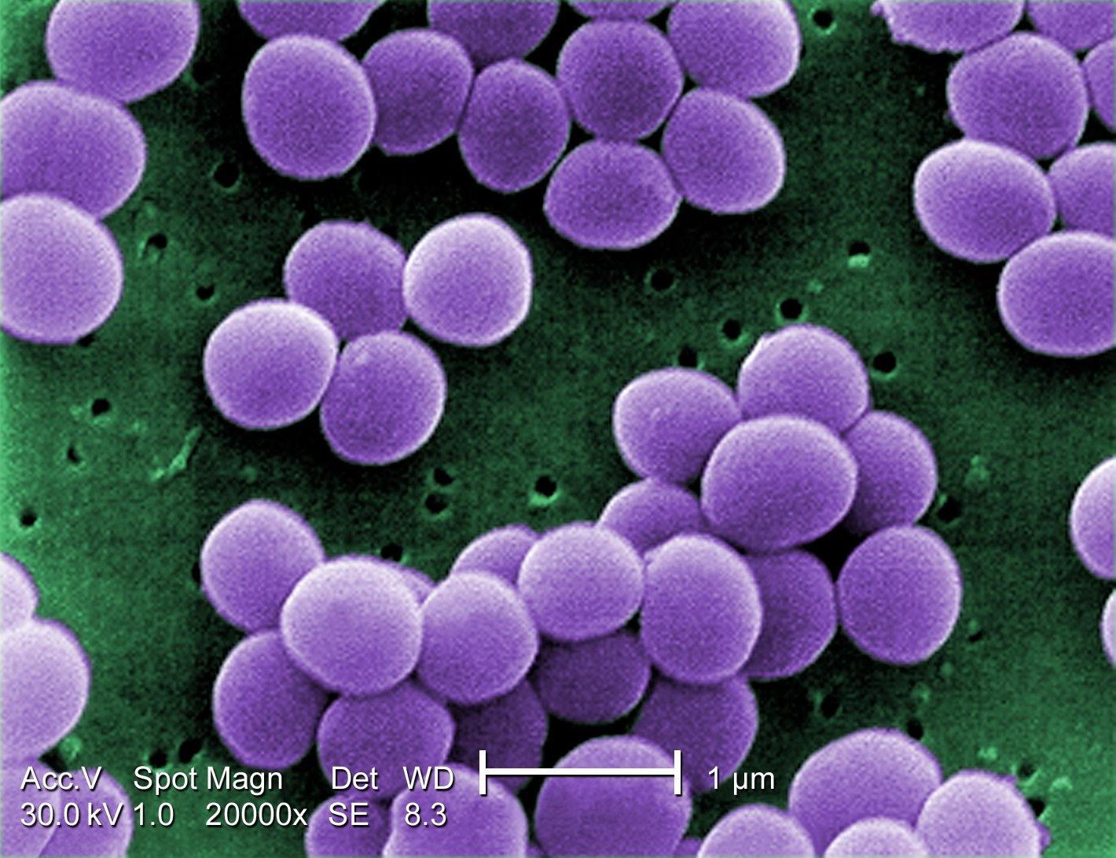
Background
Staphylococcus aureus is a gram-positive bacterial pathogen associated with a wide spectrum of diseases in humans and animals
The domestication of animals and the recent intensification of livestock farming have provided increased opportunities for the transfer of this pathogen between humans and animals
Also, the use of antibiotics in humans and animals has led to the emergence of several antibiotic resistant strains
This project looked to explore the dynamics of S. aureus at the human-ruminant-companion animal interface, as well as the antimicrobial resistance profile.
Notes:
I would say here you can use a more active title such as: “Staphylococcus aureus a pathogen with broad host range and antimicrobial resistance” instead of a generic title (Background).

Slide 3
Objectives
Illustrate the evolutionary relationships between S. aureus isolates from humans, ruminants and companion animals
Investigate jumps among host groups
Examine the distribution of antimicrobial resistant (AMR) genes across host groups
Determine the most common AMR gene across host groups
Notes:
I believe you can change the title to “Research Questions”
And simplify the bullet points as follows:
What are the evolutionary relationships among S. aureus isolated from humans, ruminants, and companion animals?
Which of these host group has the most antimicrobial resistance genes?

Slide 4

Manuscript
Notes:
This is background information, so move it up (before research questions). Also, change the title to something that tells the audience something about the manuscript, for example:
“S. aureus is a multi-host bacterial pathogen with widespread distribution”

Slide 5
Methods
Terminal
RStudio
Genomes
Annotate
Import data
Download:
SRA-tool kit
Annotation:
Prokka
R-base
Fastq files
Build core genome
Subset data
Assembly:
Spades
Core genome:
Panaroo
dplyr
Individual assemblies
Phylogenetic analysis
Plot figures
ggplot
ggtree
RAxML
Notes:
I am thinking this slide may not be needed, but you can keep it as is. Except, maybe you can change the title to a more active version, such as “Assembling datasets for phylogenetic analyses and illustrations”
Generic titles such as “Methods” are not interesting and the audience may find it boring.

Slide 6
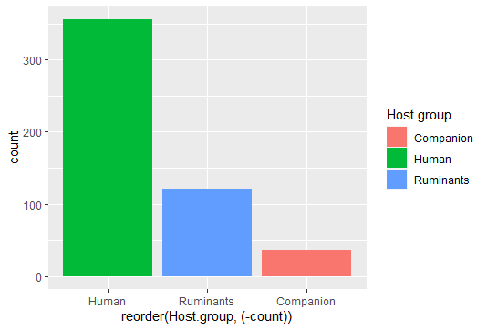
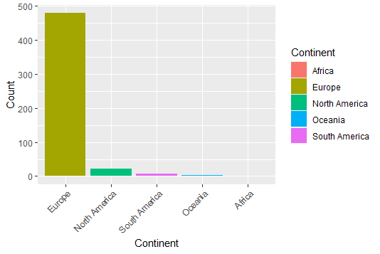
Dataset
513 isolates
3 host groups
Human - 356
Ruminants (cow, sheep, goat) - 121
Companion animals (dog, cat, horse, rabbit) -36
5 continents
58 clonal complexes
Notes:
Again, change the title to an active title that says something about the slide, not just a generic title. For example: “Most genomes of S. aureus were isolated from humans in Europe”

Slide 7
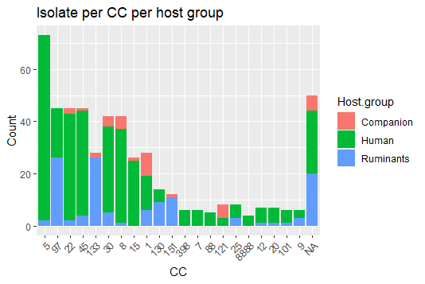
Genetic similarity of some isolates
Clonal complexes (CCs) are defined as groups of sequence types (STs) in which every ST shares at least five of seven identical alleles with at least one other ST in the group. (Enright MC et al., 2000)
CC common to all 3 groups:
22
45
30
8
1
Evidence of transmission among host groups
Notes:
This is closer to an active title. I would say something like: “Genetic diversity observed among host groups” would be better, because you found many clonal complexes (not just one or two).

Slide 8
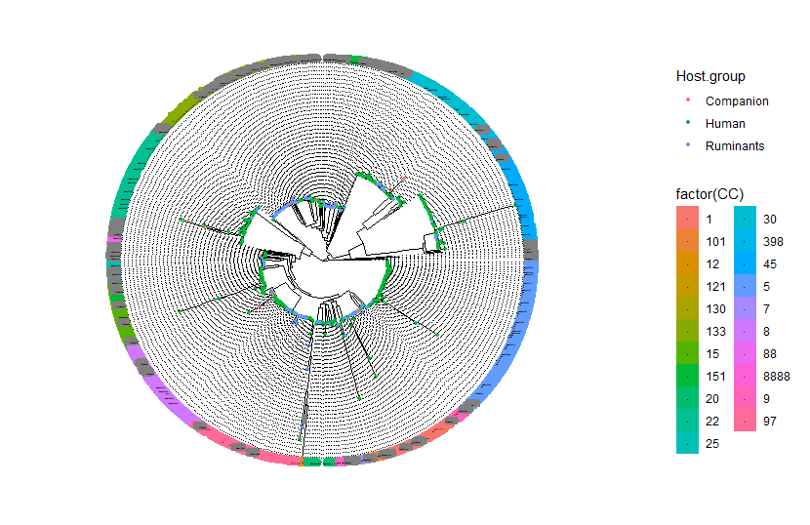
Phylogenetic tree
Notes:
An active title such as “Evolutionary relationships among S. aureus suggest host transitions (jumps)”. Then add a little text on the blank space to remind yourself about what you want to say. For instance, you could mention that S. aureus from human, companion animals, and ruminants are found in many branches and different clonal complexes, suggesting host jumps.

Slide 9
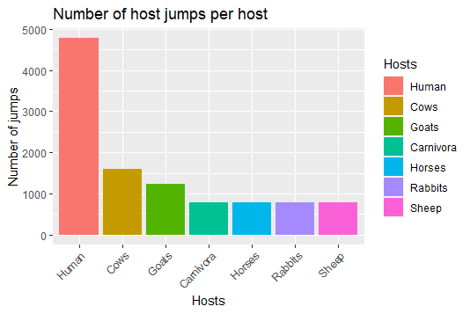
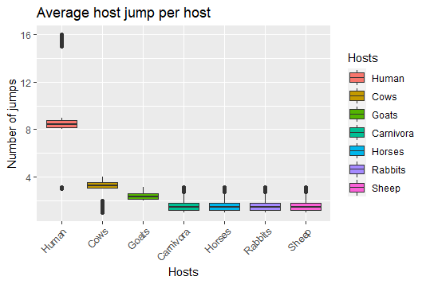
Humans – Major reservoir for spread
Anthropozoonosis & Zooanthroponosis
Notes:
This is great, but you have to subset your data as you did previously and only plot your focus groups (human vs companion animals, vs ruminants), because other people may talk about these hosts.

Slide 10
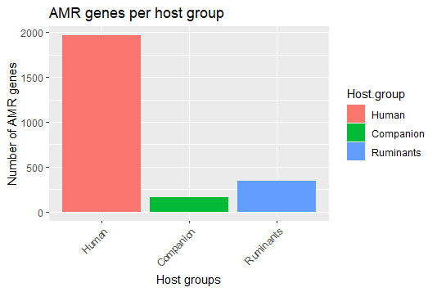
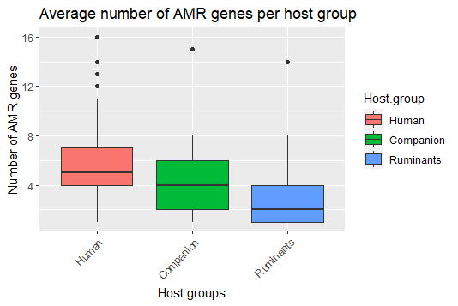
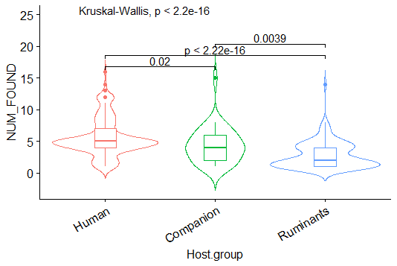
Antimicrobial resistance (AMR)
Humans > Companion animals > Ruminants
Notes:
This is great, just need an active title. You could say “More antimicrobial resistance genes found on S. aureus from humans on average”

Slide 11
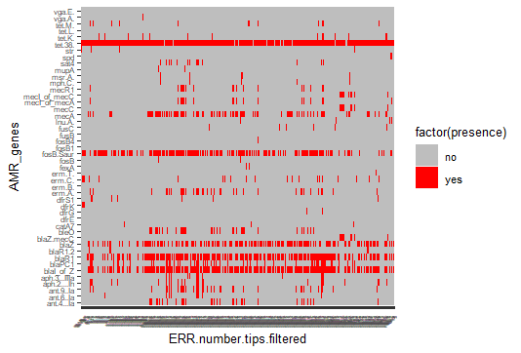
Most common AMR genes
tet38
mecA
fosB.Saur
blaZ
blaR1
blaI_of_Z
Notes:
Again, a more informative active title would help. My pitch “Six AMR genes are found in all hosts”. You have to keep in mind that other people may want to show this same image, so you should probably only show the ones for your own groups in the x axis (labeling each). You can simply change the value in the x-axis to the name of your new source group dataset (I don’t know what you called it).
You could do something like this:
melt.data <- pivot_longer(metadata.filtered.abricate, cols=35:80, names_to = "AMR_genes", values_to = "presence")
qplot(data=melt.data,
x=Source.group,
y=AMR_genes,
fill=factor(presence),
geom="tile") + scale_fill_manual(values=c("no"="grey", "yes"="red")) +
theme(text = element_text(size=10),
axis.text.y = element_text(size=6),
axis.text.x = element_text(size=6, angle=45, hjust=1))
But instead of x=Source.group, use the name that you used for the column with the human, companion and ruminant classification.

Slide 12

Gene Ontology
Gene | AMR Gene Family | Drug class | Resistance mechanism
tet38 | major facilitator superfamily (MFS) antibiotic efflux pump | tetracycline antibiotic | antibiotic efflux
fosB.Saur | fosfomycin thiol transferase | phosphonic acid antibiotic | antibiotic inactivation
mecA | methicillin resistant PBP2 | penam | antibiotic target replacement
blaR1 | BlaZ beta-lactamase | penam | antibiotic inactivation
blaZ | BlaZ beta-lactamase | penam | antibiotic inactivation
blaI_of_Z | BlaZ beta-lactamase | penam | antibiotic inactivation
Notes:
Active title example: ” What are known functions of these most common AMR genes?”

Slide 13
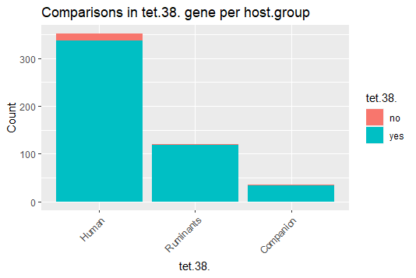
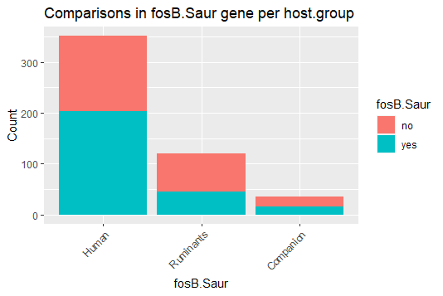
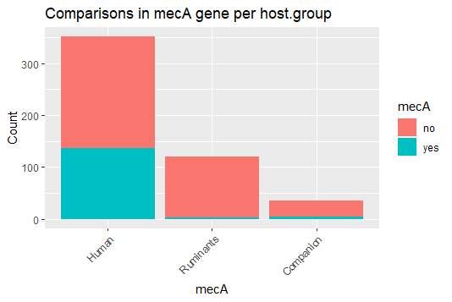
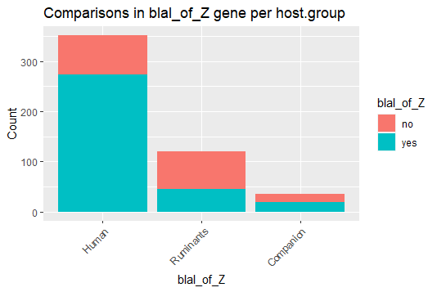
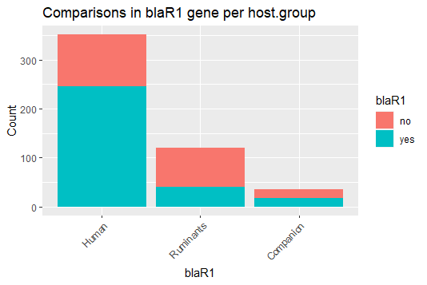
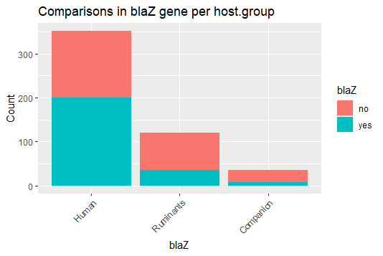
AMR genes across host groups
Notes:
Activate title: ”Amount of AMR genes per host group of interest”

Slide 14
Summary
Evidence of S. aureus transmission among humans, companion animals and ruminants
Humans are the major reservoirs for S. aureus transmission
Distribution of AMR genes: Humans > Companion > Ruminants
Tet38, conferring resistance to tetracycline is the most common gene among host groups
Significant resistance to penicillins in the human isolates

Slide 15
Thank you for listening! Questions?

